Slide 1

City of Pitt Meadows
Business Problem
The City of Pitt Meadows sought to improve its internal communication and collaboration by establishing a comprehensive intranet solution. The primary objectives were to create an Intranet Hub site, a dedicated Fire Department site, and, in the subsequent phase, implement a Custom Employee Directory and a Birthdays/Anniversaries web part. The city's existing intranet lacked the necessary structure, functionality, and user engagement features to support efficient operations and foster a connected workplace.
What We Did
Intranet Hub Site Creation: Establishing an Intranet Hub site with a well-structured information architecture serves as a centralized platform for employees to access essential resources and information.
Department Template Development: Crafting department templates streamlines the process of creating multiple department sites, ensuring consistency and efficiency across the organization.
Specialized Fire Department Site: Recognizing the unique needs of the Fire Department, Affirma likely tailored the SharePoint site to accommodate specific functionalities and features relevant to the department's operations.
Custom Employee Directory: Building a custom employee directory within SharePoint, integrated with Active Directory, enhances employee search capabilities and facilitates efficient communication and collaboration.
Birthdays and Anniversaries SPFx Web Part: Implementing a custom SPFx web part to display birthdays and anniversaries demonstrates a personalized approach to employee recognition and engagement. Leveraging Power Automate to retrieve data from Azure Active Directory streamlines the process of updating employee milestones.
Overall, Affirma's involvement has significantly contributed to enhancing the digital workplace experience for the City of Pitt Meadows employees, fostering collaboration, efficiency, and employee engagement.

Slide 2
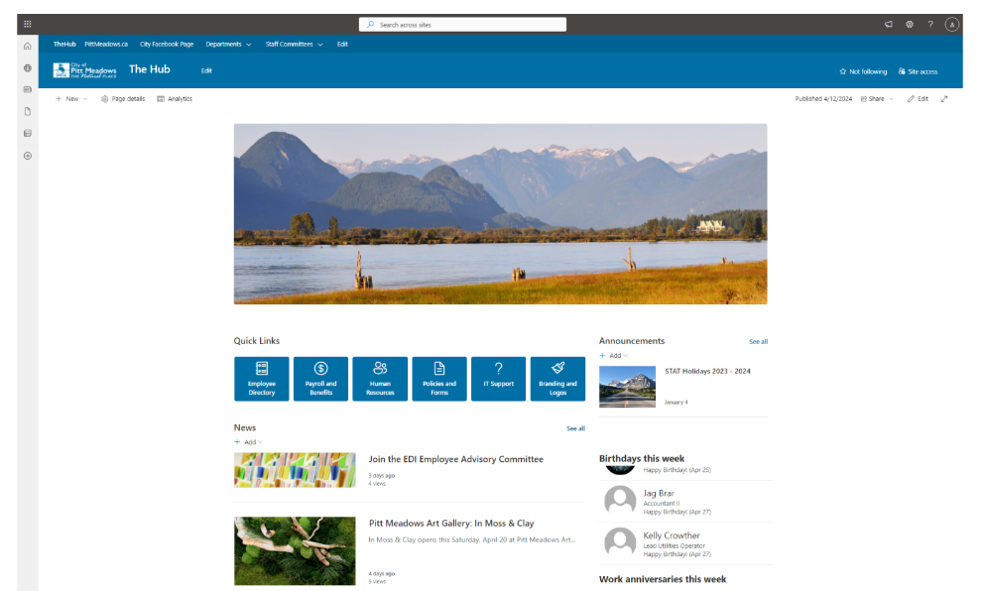
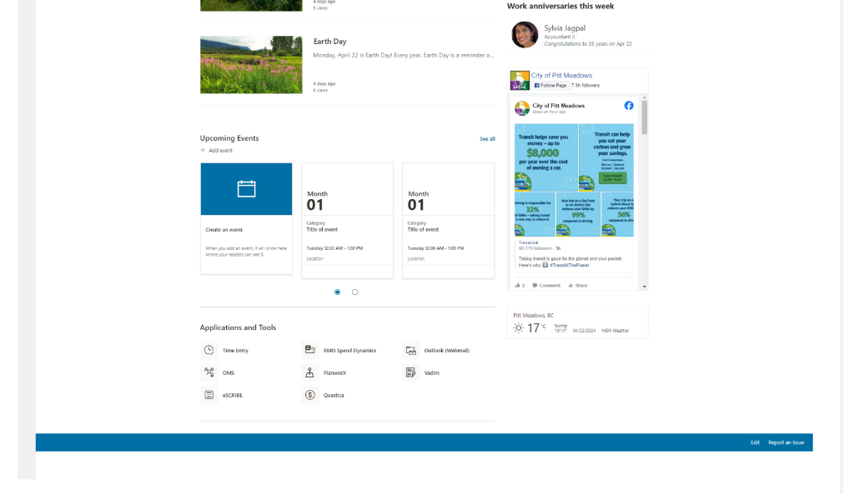
City of Pitt Meadows SharePoint “Hub Site”

Slide 3
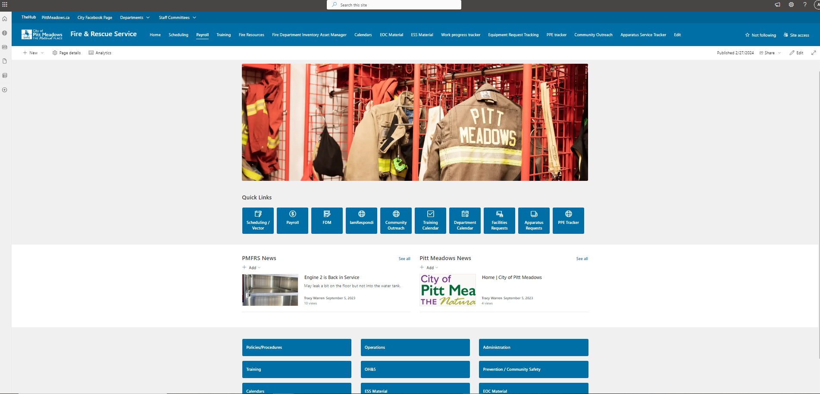
City of Pitt Meadows SharePoint “Fire and Rescue Site”

